Slide 1
Emotional Wellness
August 5, 2020
Facilitator: Basil Joseph, M.Ed., RP, RMFT

Slide 2
EMOTIONAL Wellness
You will learn, identify, and apply…….
5 Indicators
4 Strategies
3 Personal Goals
2 Minutes of Mindfulness Meditation
1 Coping Statement
…….for your Emotional Wellness

Slide 3
Emotional Wellness
5 Indicators
You are…..
Kind & treat others well
Self compassionate & like yourself
Aware of your emotions
Resilient & rebound from failure
Finding meaning & purpose in life
Remember it is not either/or…..it’s a continuum

Slide 4
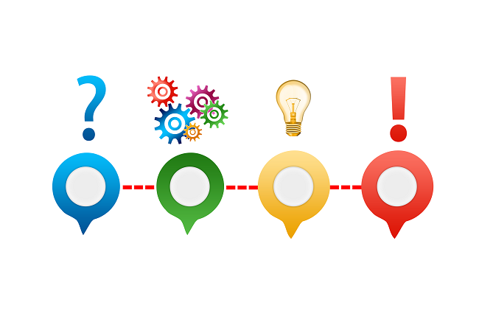
Emotional Wellness
4 Strategies
Bullet Journalling
Developing Self Compassion
Practicing Mindfulness
Nurturing your interests/hobbies

Slide 5
Bullet Journal Video: https://www.youtube.com/watch?v=boeojSvp5Mg

Slide 6
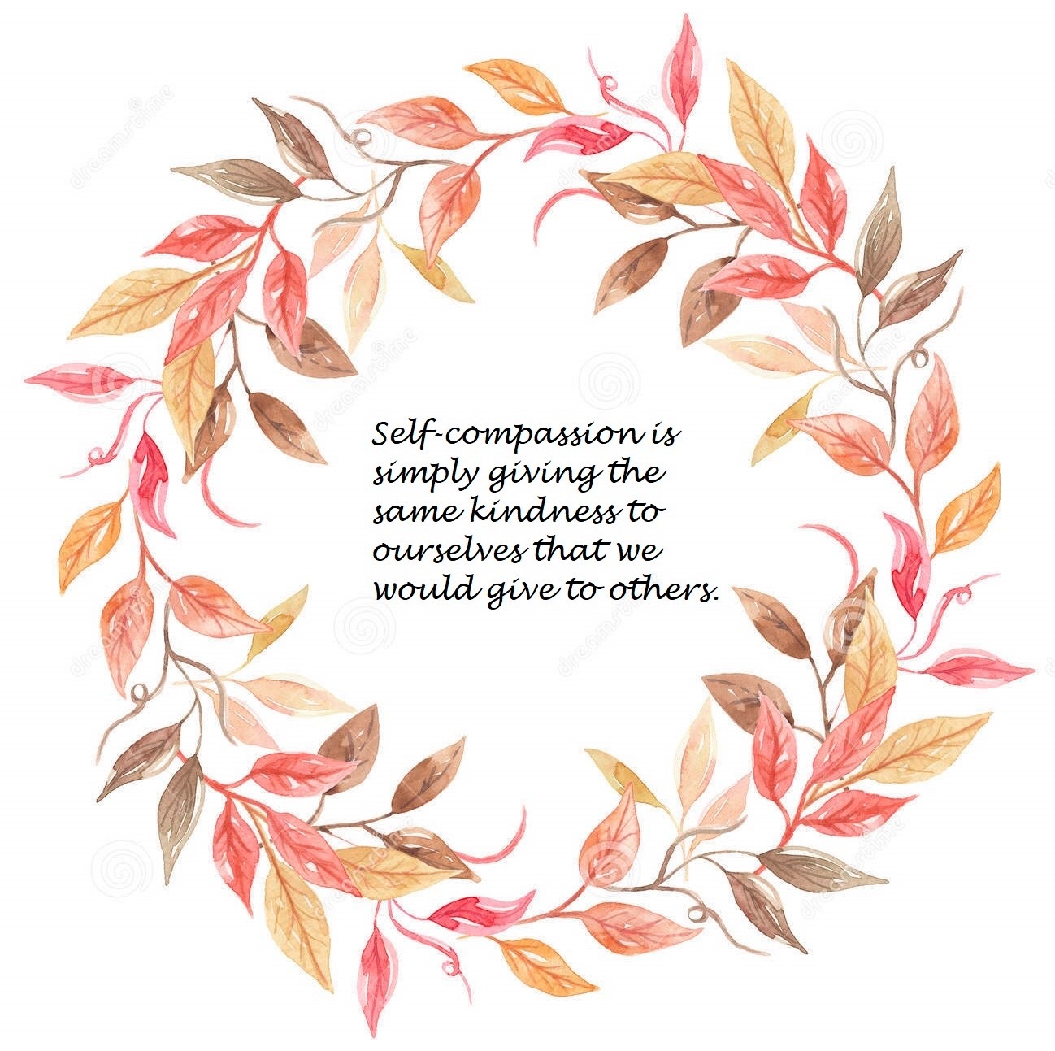
Self Compassion: Kristin Neff at TEDx
The Space Between Self-Esteem and Self Compassion
https://www.youtube.com/watch?time_continue=39&v=IvtZBUSplr4&feature=emb_logo

Slide 7
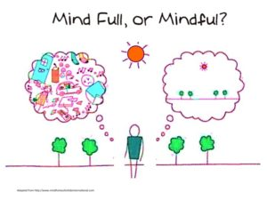
Mindfulness:
Sheridan Mindfulness Group
&
Free apps

Slide 8
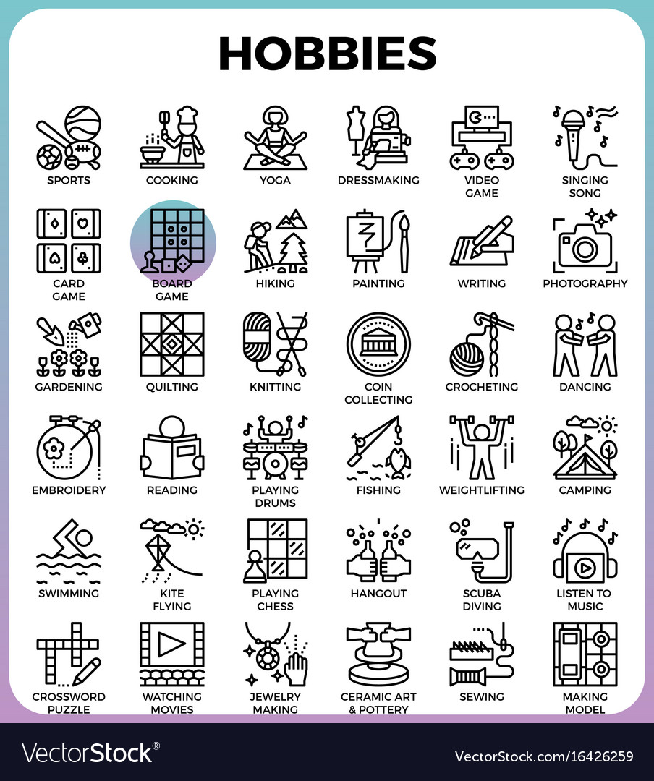
Nurturing your Interests/hobbies:

Slide 9
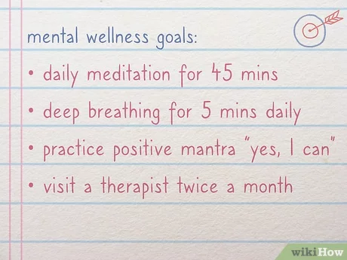
Emotional Wellness
3 Goals
Activity:
Write 3 goals to increase your emotional wellness

Slide 10
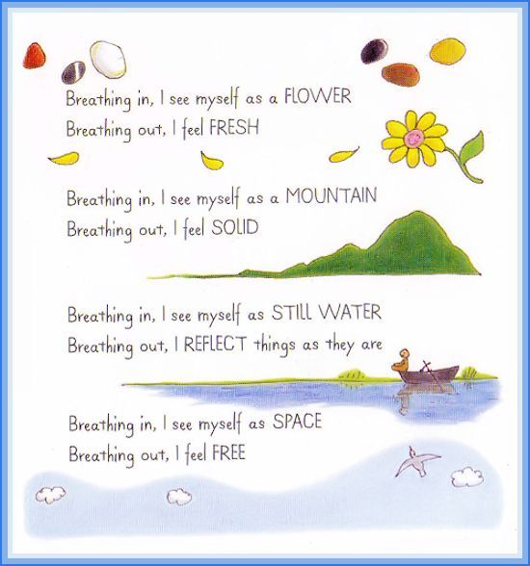
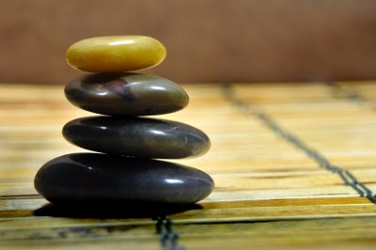
Emotional Wellness
2 Minutes of Mindfulness Meditation
Pebble Meditation

Slide 11
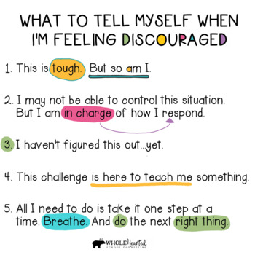
Emotional Wellness
1 Coping Statement
Activity:
Write 1 coping statement

