Slide 1
GDC2019 Proposal
Presented by:
Del Nordlund, Sebastian Scaini, Jackson Lanaus, Gavin Nelson, Xin Zhang

Slide 2
What is ?
March 18-22, 2019 I San Francisco, CA
https://www.youtube.com/watch?v=aop6SoSQd_Y

Slide 3
What is the Game Developers Conference?
GDC is the world's largest professional game industry event.
28,000 attendees with five days of education, inspiration, and networking at the Moscone Convention Center in San Francisco.
Programmers, artists, producers, game designers, audio professionals, etc.
Features 750 lectures, panels, tutorials and roundtable discussions on game development by industry experts.
Showcases the latest game development tools and services from 550 leading technology companies.
GDC hosts two award ceremonies.
The Game Developers Choice Awards celebrates the industry’s top games and developers.
The Independent Games Festival honor various projects in indie game development.

Slide 4
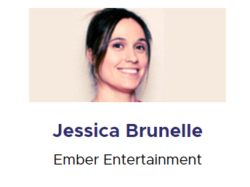
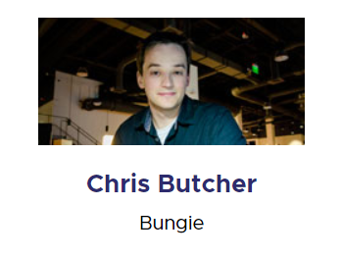
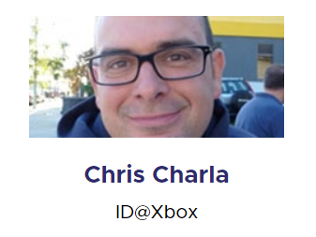
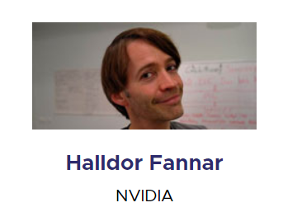
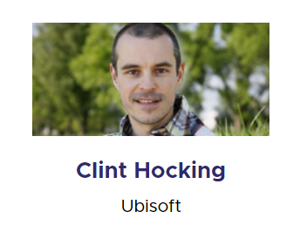
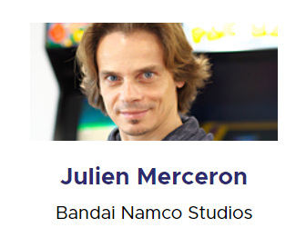
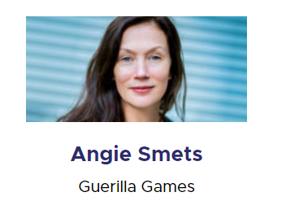
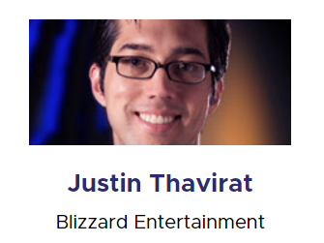
Advisory Board

Slide 5
alt.ctrl.GDC
alt.ctrl.GDC is one of GDC's most acclaimed community spaces where visitors can play games using alternative controllers and meet the developers behind these projects.
One of these games will win the alt.ctrl.GDC Award which includes a $3,000 prize plus a special trophy handmade by game maker Robin Baumgarten, with judging taking place on-site.

Slide 6
Plünge (by Del Nordlund, Darryl Feniquito, Gavin Nelson, Jackson Lanaus, Patrick Flattery, Sebastian Scaini, Sprite Man Vuk, Xin Zhang) is designed to be controlled via the unique motions and functions of a household toilet plunger.
Interesting one-button game design keeps the mini-games fresh and exciting, while short play sessions allow people to come, plunge and leave without commitment.
Application date Nov. 6, 2018/notification date Dec. 7, 2018

Slide 7
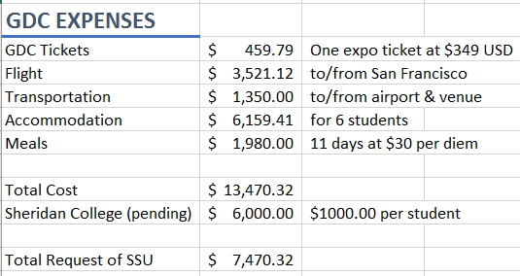
Cost Breakdown
What We Have:
3 conference + summits passes ($2099 USD each)
2 expo plus passes ($349 USD each)
What We Need:

Slide 8
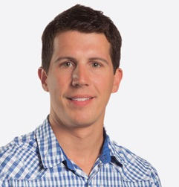
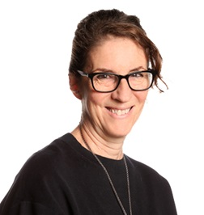
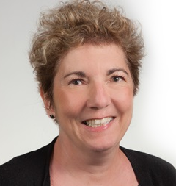
Who’s in SSUpport
Nicolas Hesler
Coordinator, Bachelor of Game Design
Ronni Rosenberg
Dean, Faculty of Animation, Arts & Design
Angela Stukator
Associate Dean, Animation and Game Design
THE SSU(?)

Slide 9
Impact on our team
EXPANDING OUR KNOWLEDGE AND SKILLS
THE EDUCATIONAL AND PROFESSIONAL EXPERIENCE
MEETING INDUSTRY PROFESSIONALS
NETWORKING FOR THE FUTURE

Slide 10
Impact on Sheridan and the SSU
BRINGING SHERIDAN TO THE INTERNATIONAL STAGE
SHARING THE EXPERIENCE WITH OTHERS
We will be happy to share our experiences through:
Workshops and professional development sessions
Social media content for the SSU (show what you helped make happen!)
Any Suggestions(?)

Slide 11
THANK YOU FOR LISTENING!
Questions?

