Slide 1
WARM UP

Slide 2
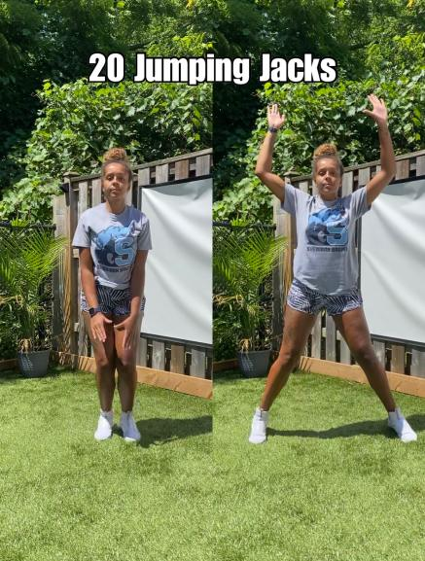

Slide 3
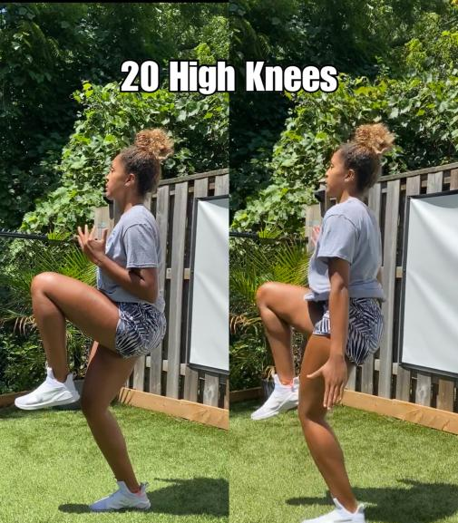

Slide 4
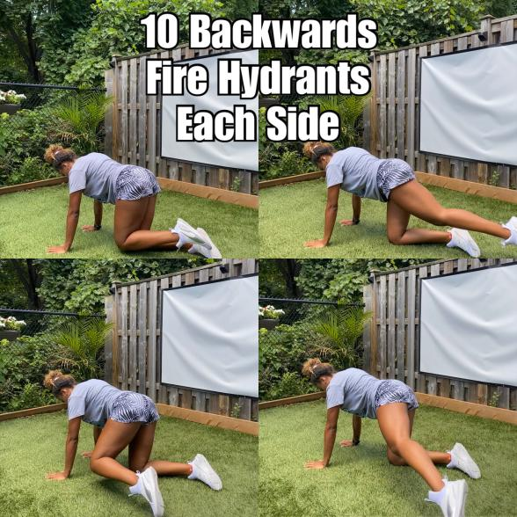

Slide 5
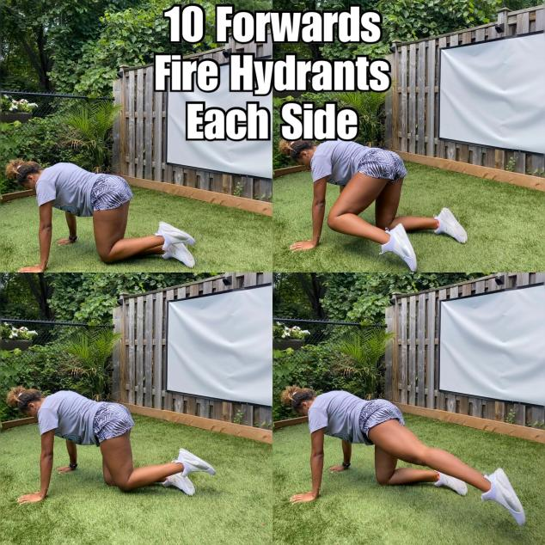

Slide 6
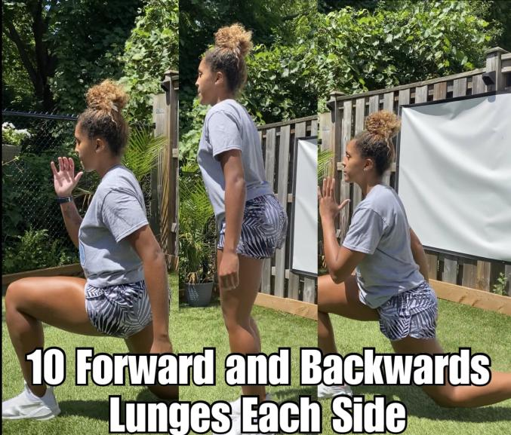

Slide 7
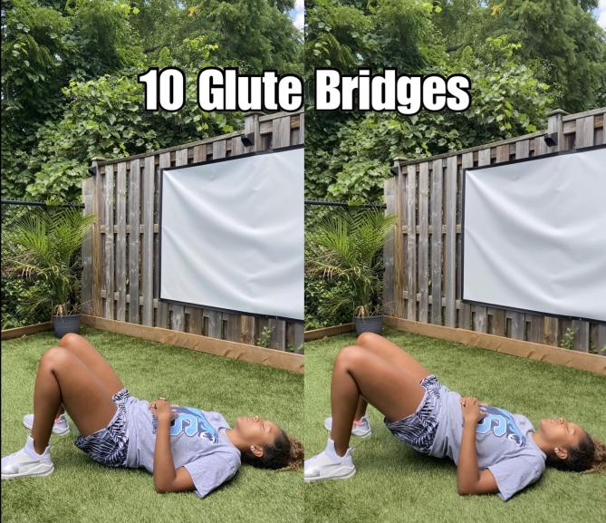

Slide 8
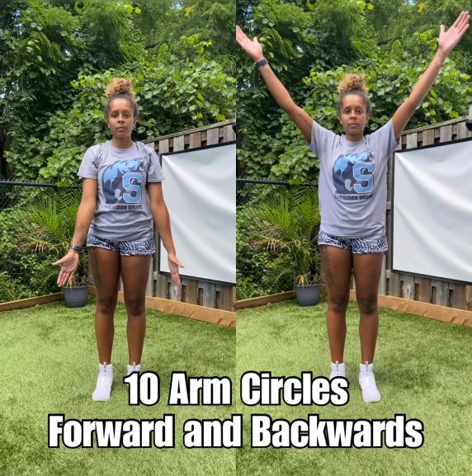

Slide 9
STRENGTH

Slide 10
BLOCK 1
Perform For 3 Sets

Slide 11
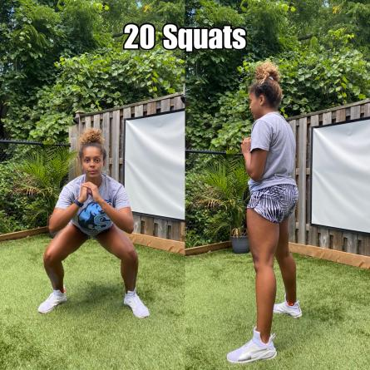
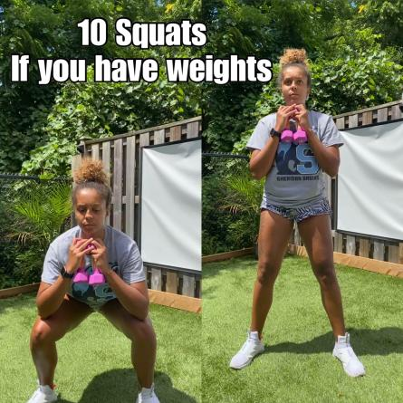

Slide 12
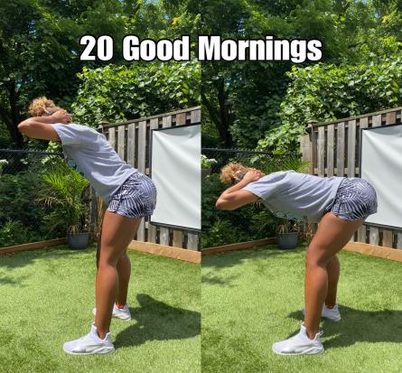
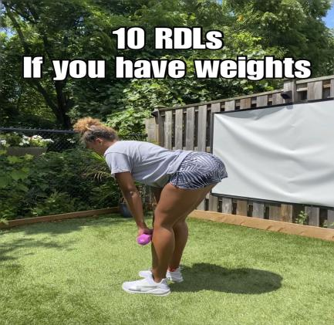

Slide 13
Block 2
Perform For 3 Sets

Slide 14
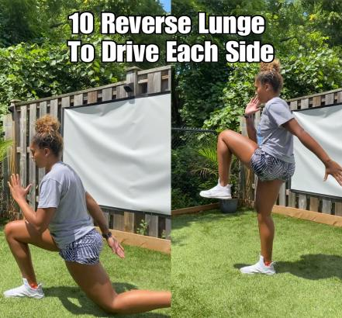
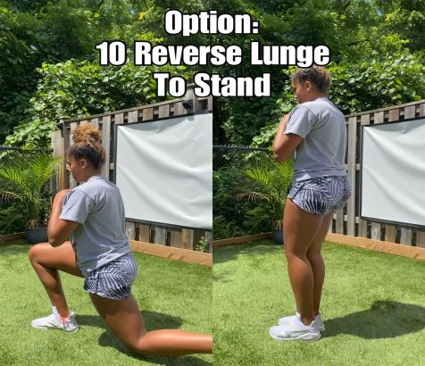

Slide 15
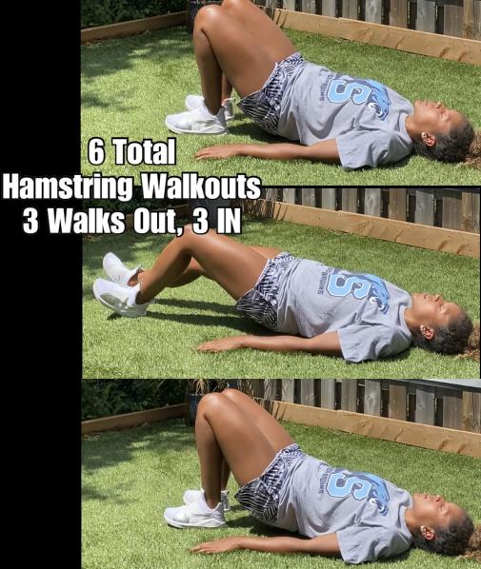

Slide 16
CORE

Slide 17
Block 3
Perform For 2 Sets

Slide 18
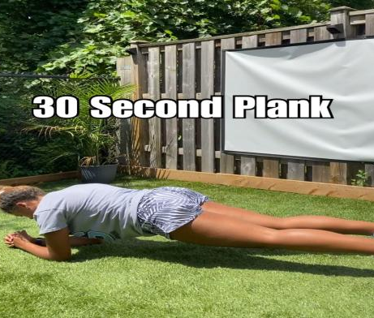
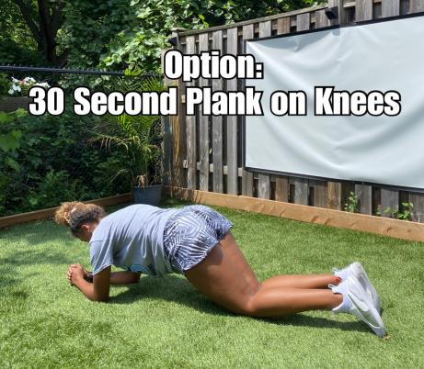

Slide 19
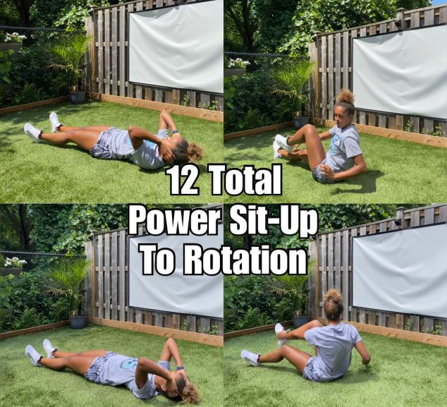

Slide 20
Block 4
Perform for 2 Sets

Slide 21
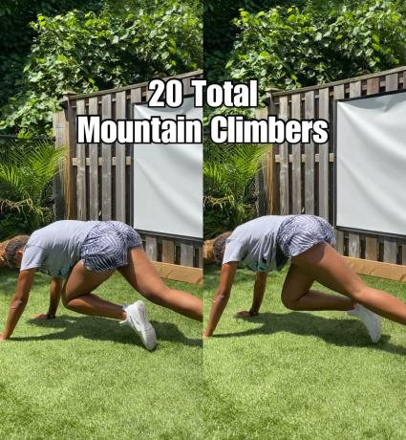
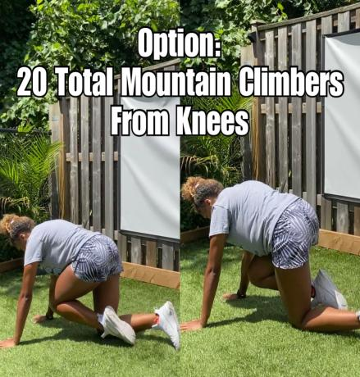

Slide 22
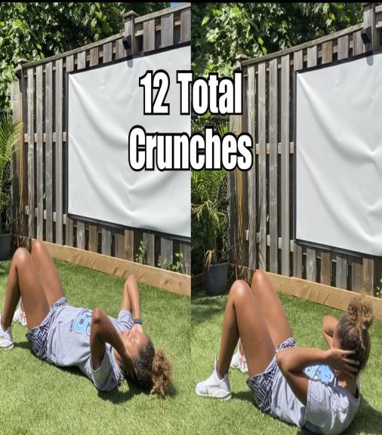

Slide 23
CRAZY CARDIO TO FINISH!
Round 1: Both Exercises 1 Minute ON, 30 Seconds OFF
Round 2: Both Exercises 45 Seconds ON, 30 Seconds OFF
Round 3: Both Exercises 30 Seconds ON, 30 Seconds OFF

Slide 24
ROUND 1
1 MINUTE ON, 30 SECONDS OFF

Slide 25
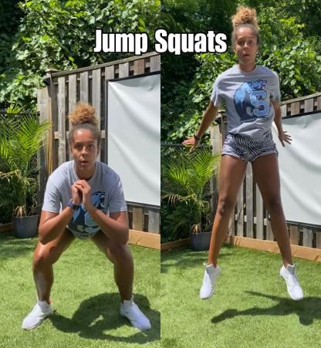
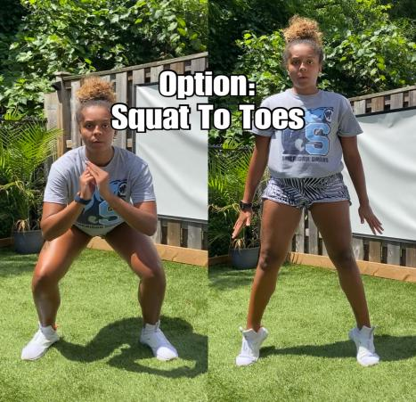

Slide 26
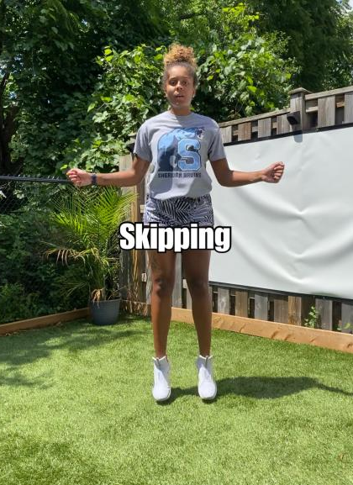

Slide 27
ROUND 2
45 SECONDS ON,
30 SECONDS OFF

Slide 28
ROUND 3
30 SECONDS ON,
30 SECONDS OFF

Slide 29
COOLDOWN

